Slide 1


Text Clustering
Yuanyue Liu
Faculté de génie | Faculty of Engineering
uOttawa.ca

Slide 2
Agenda
2
Introduction
Purpose
Sample
Data preprocessing
01
02
Clustering
K-means
Hierarchical
Expectation-Maximization (EM)
Evaluation
03
04
Conclusion

Slide 3
Introduction
Purpose
Produce clusters using different clustering algorithms
Evaluate and analyze algorithms
Determine the optimal combination of transformation and clustering model

Slide 4
Introduction
Data preprocessing
Convert all letters into lower case
Remove punctuations
Tokenize the documents to remove stopwords (nltk library)
Lemmatization
Sample
Exclude books in which there are fewer than 200*150 words.
Randomly selected 5 books written by different authors
Randomly selected 200 chunks from each book and labeled them (make sure each chunk has 150 words)

Slide 5
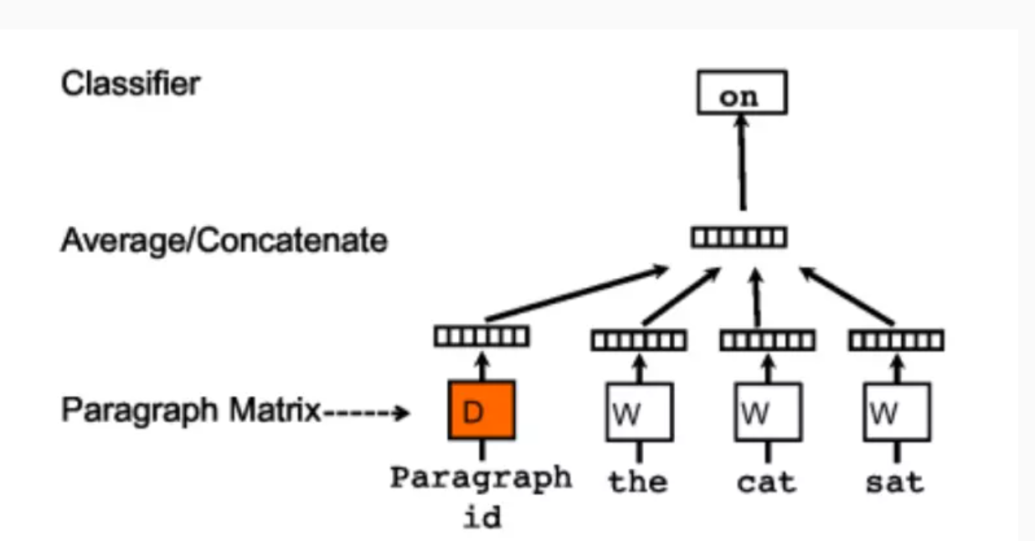
Doc2Vec
2

Slide 6
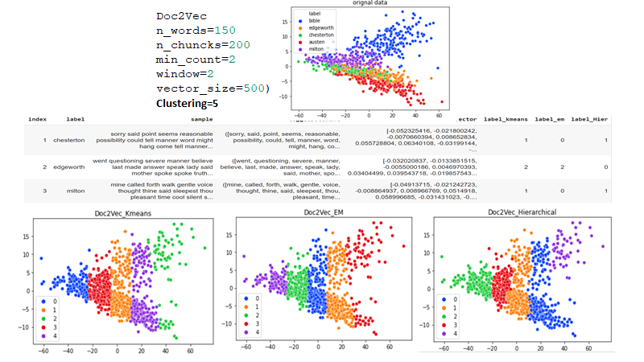
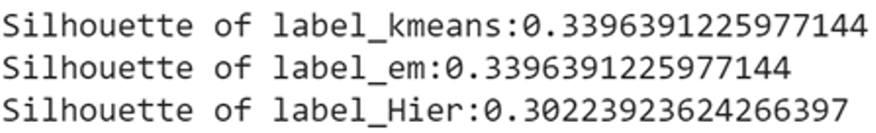
Document Embedding

Slide 7
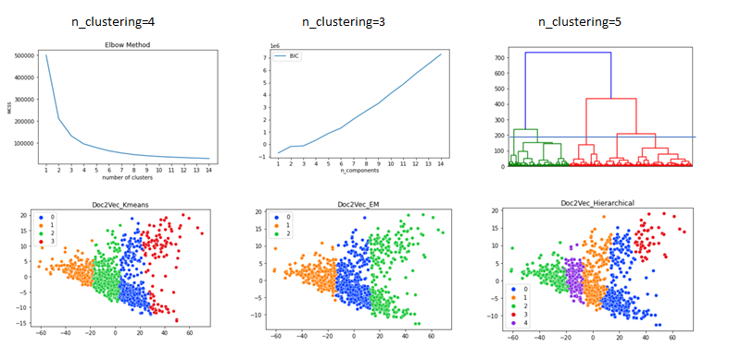
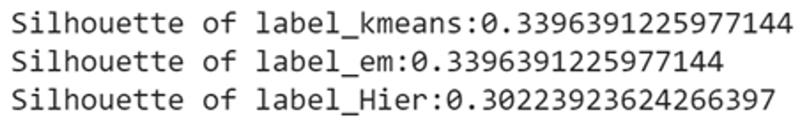
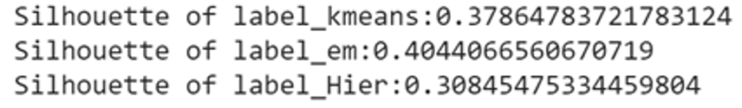
Improvement

Slide 8
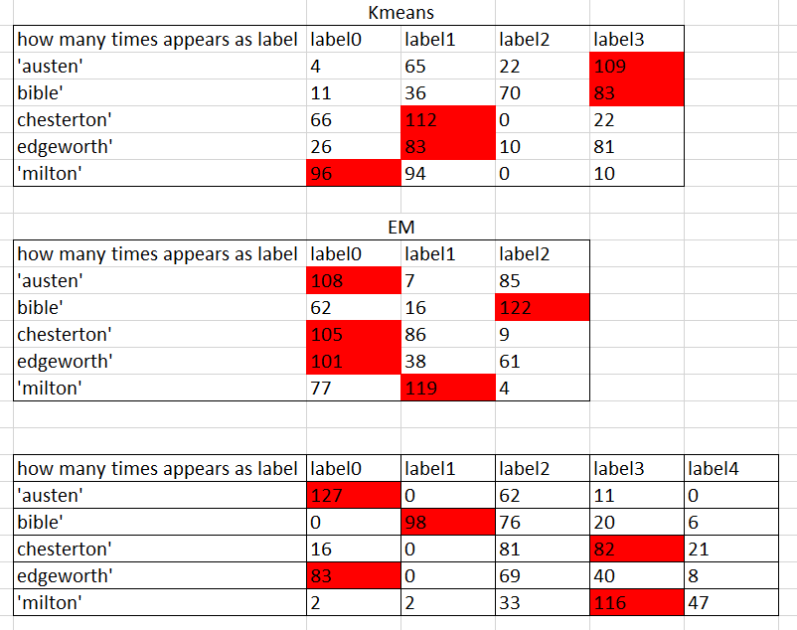
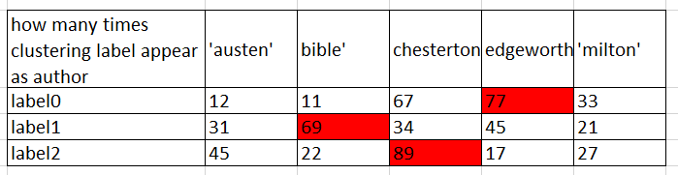
Performance (Kappa)
Mark the author with digital label
based on its appearing frequency.
A 0
A 0
B 0
B 0
B 0
A,B：0
or
0:B
?
Mark the digital label with author
based on its appearing frequency.

Slide 9
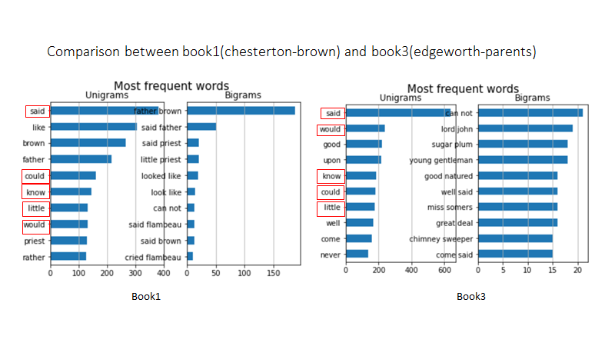
Error Analysis

Slide 10
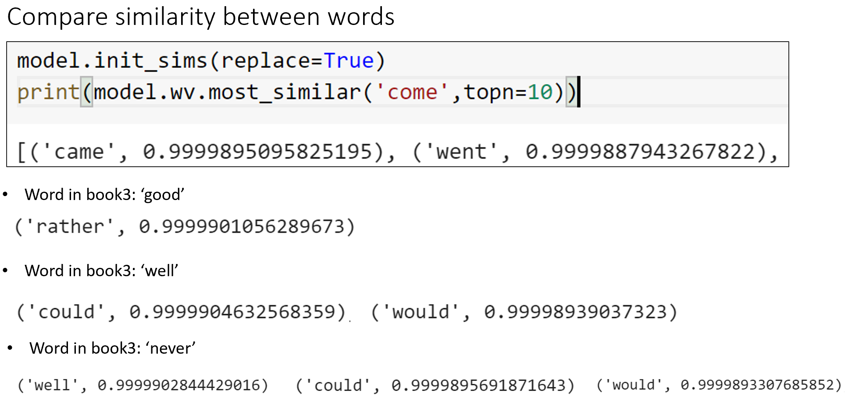
Error Analysis

Slide 11
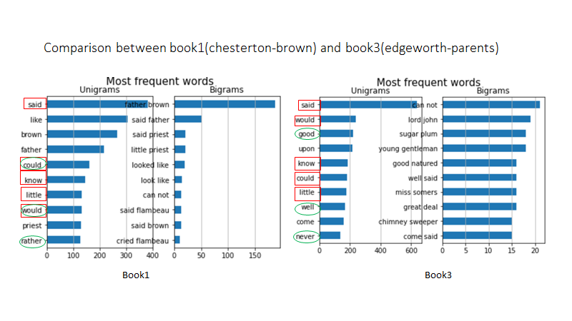
Error Analysis

Slide 12
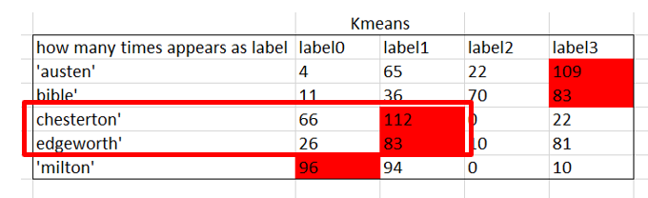
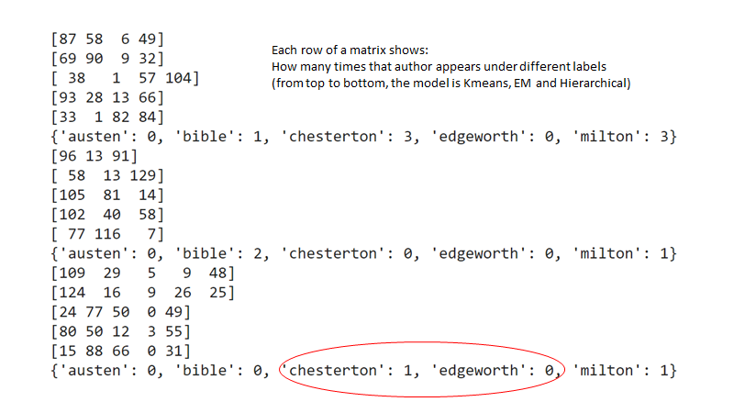
Improvement
Result after dropping ‘MD’ Tags

Slide 13
Conclusion
 | Word2Vec
 | K-means | Hierarchical | EM
Silhouette score | 0.3396 | 0.3396 | 0.3022
Kappa score | 0.1162 | 0.0425 | 0.0125

Slide 14
Thank you!
14

